Slide 1


Advantages and Disadvantages of Modern Science
Modern science has fundamentally transformed various aspects of our daily lives through remarkable advancements in technology, medicine, and communication. These developments have greatly enhanced our ability to understand and interact with the world. However, they also bring significant challenges, including ethical concerns regarding research and applications, environmental impacts from industrial practices, and the widening digital divide that affects access to resources and information. Therefore, it is crucial to maintain a balanced perspective that recognizes both the benefits and drawbacks of modern scientific advancements.

Slide 2





Benefits of Modern Science
1
2
3
4
Technological Advancements
Medical Progress
Improved Agricultural Practices
Environmental Awareness
Advanced treatments and vaccines improve health outcomes.
Innovations in technology have enhanced daily life.
Scientific advancements increase crop yields and food security.
Promotes sustainable practices and renewable energy development.

Slide 3




Ethical Concerns in Science
Bioethics
Artificial Intelligence Risks
The manipulation of genetic material raises ethical questions about the limits of scientific intervention in nature, as well as concerns regarding designer babies and genetically modified organisms.
1
The rapid development of AI presents ethical dilemmas surrounding privacy, surveillance, and the potential for biased algorithms, posing risks to society if not managed properly.
2
Access to Resources
Research Misconduct
The disparity in access to scientific advancements highlights inequity, where developed nations benefit more from medical and technological breakthroughs compared to developing nations.
4
Issues such as plagiarism, data fabrication, and unethical experimentation undermine public trust in science and can lead to harmful consequences in real-world applications.
3

Slide 4




Environmental Impact of Science
1
Pollution and Waste
2
Resource Depletion
Industrial advancements result in pollution, contributing to air and water quality issues, which threaten public health and biodiversity.
Modern science often drives over-exploitation of natural resources, leading to deforestation, fossil fuel depletion, and loss of biodiversity.
3
Climate Change
4
E-waste Challenges
Scientific progress contributes to climate change through increased greenhouse gas emissions from industrial activities.
Rapid technological advancement results in substantial electronic waste, raising concerns over recycling, disposal, and toxic materials.

Slide 5
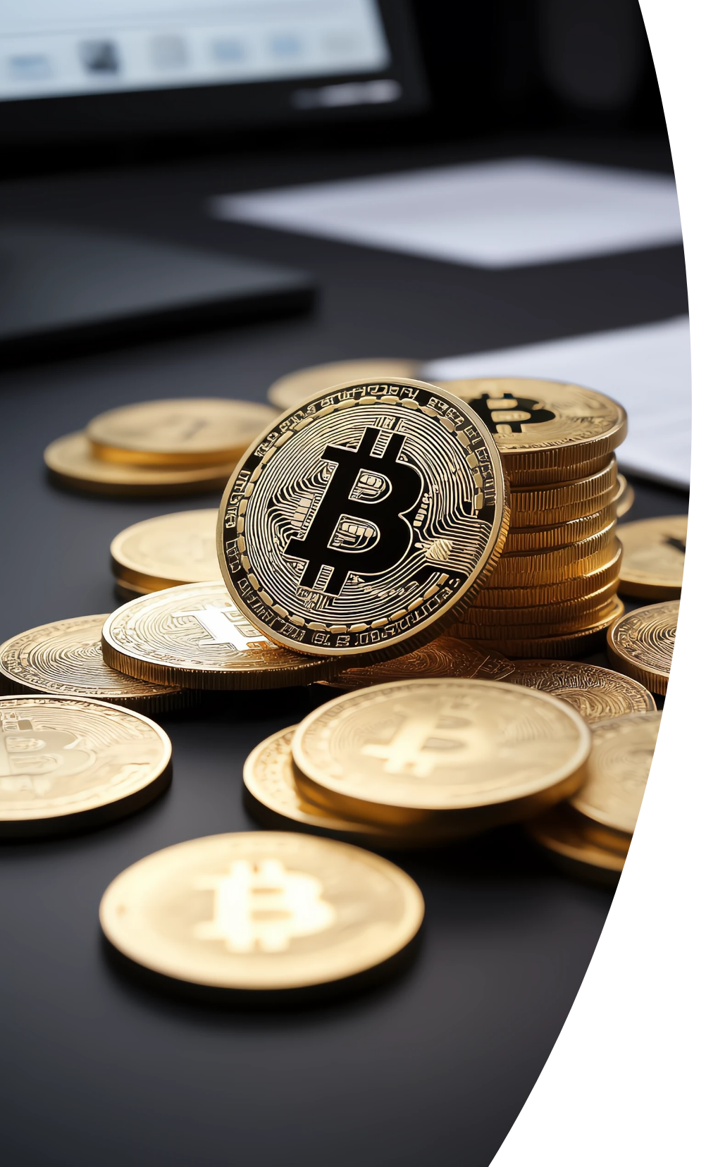

The Digital Divide
Access to Information
Education Inequality
Disparities in technology access lead to a digital divide.
Limited educational resources for low-income communities.
Job Displacement
Cybersecurity Risks
Automation displaces workers in low-skill roles.
Increased tech use poses new cybersecurity challenges.

Slide 6




Future Directions in Science
As we look towards the future of science, it is critical to embrace interdisciplinary research, enhance public engagement, develop regulatory frameworks, and prioritize sustainability. These directions will shape how scientific advancements can address complex global challenges and contribute to a healthier planet.
Interdisciplinary Research
Public Engagement
Integrating various disciplines to address complex global issues.
1
2
Increasing public understanding and participation in scientific discourse.
Sustainability Focus
Regulatory Frameworks
4
3
Prioritizing advancements that promote ecological balance.
Developing robust regulations for emerging technologies.

Slide 7

Conclusion on Modern Science
Balanced Perspective
Collaborative Efforts
Continuous Adaptation
Understanding the benefits and drawbacks of modern science is essential for harnessing its potential while minimizing risks.
Addressing challenges posed by modern science requires a collaborative approach involving diverse stakeholders.
The rapid pace of scientific change necessitates ongoing adaptation in ethical standards and regulatory measures.

